Slide 1
Flipping Online: Creating an Active Learning Classroom in an Online Biostatistics Course
Joint Statistical Meetings, Vancouver
July 31, 2018
Ann M. Brearley* and Laura J. Le
Division of Biostatistics
University of Minnesota
brea0022@umn.edu

Slide 2
Outline
How we use active learning in our in-person class
How we have adapted active learning to work in an online class
Feedback from online students

Slide 3
Setting
Introductory course, Biostatistical Literacy, which aims to develop students’ ability to read and interpret statistical results in the medical and public health literature.
Online course using the Moodle learning management system.
Graduate students in public health (e.g., MPH, DVM/MPH) and medical professionals (e.g., MD, DNP, DDS, PharmD).
50 – 80 students per term.

Slide 4
Topics
Study designs and sampling methods
Descriptive statistics
Hypothesis testing and confidence intervals
T-tests, Chi-square tests, ANOVA
Odds ratios and relative risks
Screening tests
Correlation and simple linear regression
Multiple linear regression
Logistic regression
Survival analysis
Kaplan-Meier curves, log-rank tests, proportional hazards regression

Slide 5
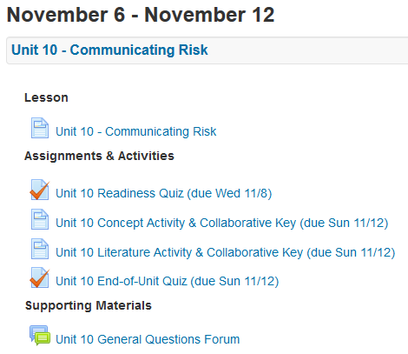
Learning objectives, readings and recorded lectures
Notes:
Example unit outline (Fall 2017 online)

Slide 6
Learning Objectives: Example
Unit 12: Multiple Linear Regression (MLR)
Be able to describe when multiple linear regression can be used, and what it is used for.
Be able to write down the equation for a multiple linear regression model (including interaction terms) and describe what each parameter means.
Know what kind of a plot is used to assess how well a multiple linear regression model fits the data, and be able to interpret both the plot and the model R2 value.
Be able to interpret the fitted model regression coefficients, and make a conclusion from their confidence intervals and p-values.
Be able to explain what ‘variable selection’ is, how to recognize it in an article, and why it is a potential issue.
Be able to recognize or give examples of study designs which result in correlated data and cannot be analyzed using MLR.
Notes:
Students are encouraged to use the learning objectives to guide their learning.

Slide 7
Readiness Quizzes
Formative assessment
Tests a basic level of understanding (e.g. terminology), so students are prepared for the learning activities
About 20 multiple-choice questions, takes ~20 minutes
Administered online
Weekly, one per unit, so low stakes
Can take it twice, best score counts
Encouraged to take it with a study partner or group
Notes:
The quiz itself is a learning activity.

Slide 8
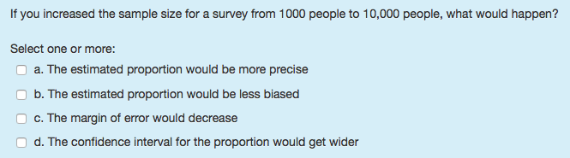
Readiness Quiz: Example Question

Slide 9
End-of-Unit Quizzes
Summative assessment
Directly tied to the week’s learning objectives
About 6 short-essay questions, takes ~1 hr.
Administered online
Weekly, one per unit, so low stakes
Taken once, independently

Slide 10
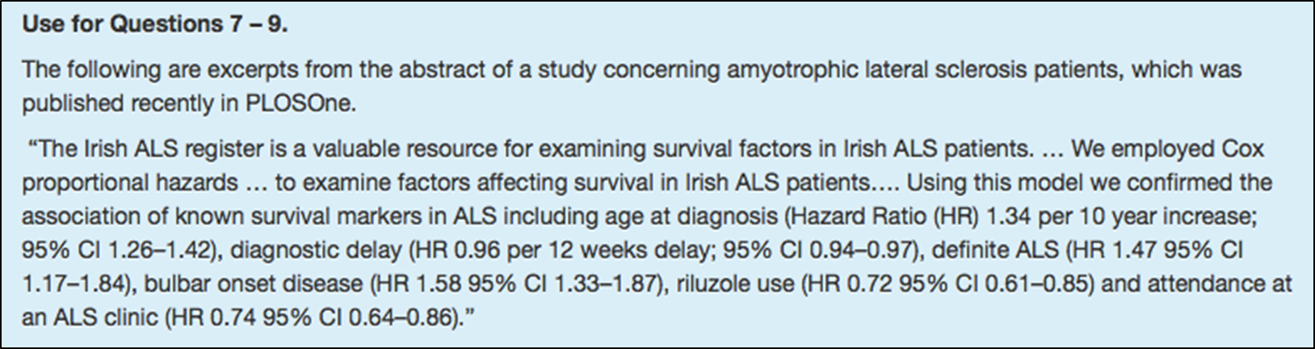
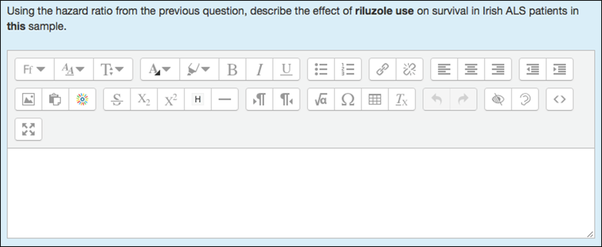
End-of-Unit Quiz: Example Question

Slide 11
In-Class Learning Activities
Tuesdays: Concept Activity
Focus is on understanding a key concept for the unit, e.g. what is a sampling distribution
Some of these involve using software applets such as StatKey
Thursdays: Literature Activity
Focus is on reading and understanding an article from the medical or public health literature
Notes:
Each activity takes one class period, or about 1.25 hours.
Students work in table groups or pairs
Active classroom is ideal, but any classroom with movable tables and chairs works
Instructor(s) and classroom TA circulate to answer questions, listen for confusion, ask questions
Two instructors/CTAs are sufficient for a class of about 50 students

Slide 12
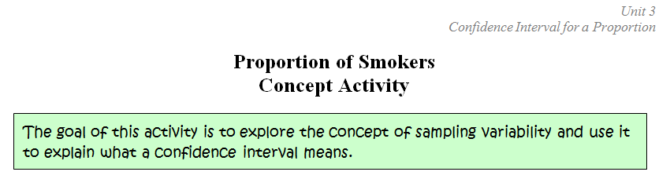
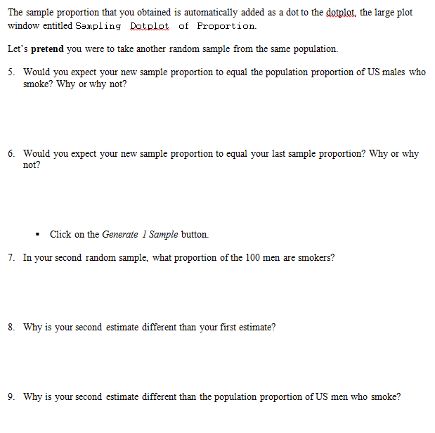
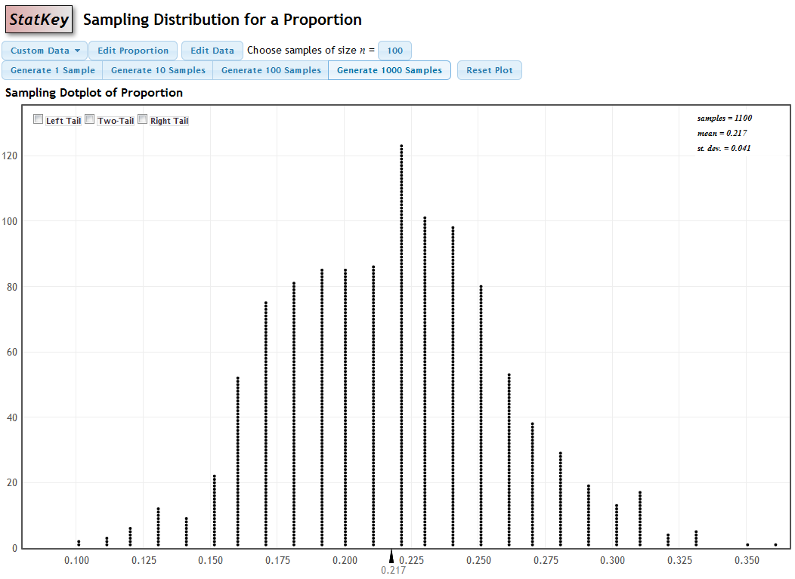
Notes:
Concept activity worksheet
Clear objective
Q&A format – typically about 4 pages long
Questions guide students through

Slide 13
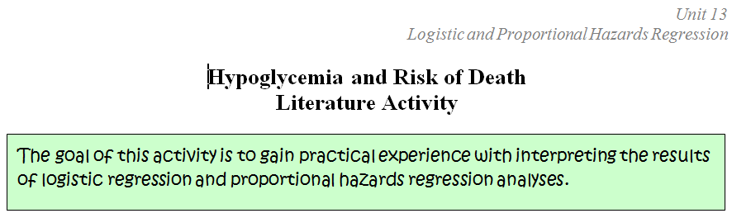
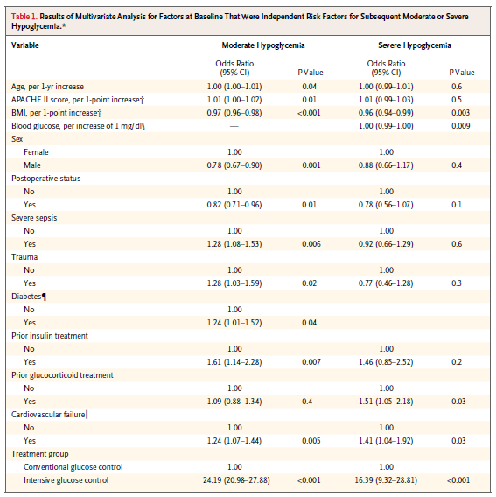
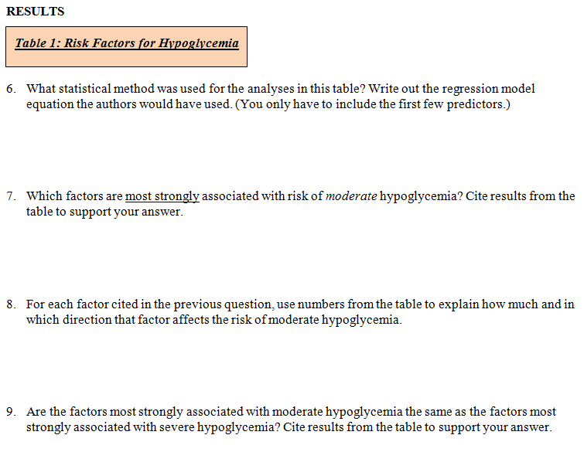
Notes:
Similar format to CA.
The literature activity typically has sections on:
- Research question and findings
- Methods
- Results
- Discussion
…so they read the WHOLE article, but the primary emphasis is on the results section, shown here.
Intentionally focus on big complicated tables and figures, to de-sensitize students.
Articles are from the current medical or public health literature.
Students read ~15 complete articles over the semester. When they find they can really read the articles in their field, they are very pleased!!
Article: “Hypoglycemia and Risk of Death in Critically Ill Patients” by the NICE-SUGAR Study Investigators (2012), N Engl J Med 2012;367:1108-18.
DOI: 10.1056/NEJMoa1204942.

Slide 14
Active Learning Classroom Benefits
Biostatistics is scary; active learning allows students to do the hard parts in a supportive environment, with classmates, instructors nearby to help.
vs. traditional approach: students wrestle with the hard parts alone at home doing the homework.
More challenging material can be used, since the instructors are on hand to help.
It keeps students engaged.
Learning is enhanced and reinforced by explaining to / arguing with classmates.
Plus it is way more fun!
Notes:
How do we reproduce the active learning classroom environment in an asynchronous online class, so that the online students will have these benefits as well?

Slide 15
Active Learning ‘Classroom’ Online
Students work independently or in groups to complete the activities (using Skype, etc.)
Students work collaboratively as a class to create the answer keys for the activities via Google Documents.
“Collaborative keys”
Instructor(s) and TAs monitor the developing keys throughout the week.

Slide 16
Ways to Contribute
If blank, post an answer to a question.
If a question has a correct answer, but you think there are alternative correct answers, add your alternative.
If a question has an answer, but you think it is incorrect, add a comment and/or post what you think is the correct answer.
If a question has an answer, but you think the concept is confusing or needs additional explanation, ask a question OR provide a clearer explanation.
Post any additional thoughts you had while answering the question.
Answer additional questions posed by the instructor or TAs.
Notes:
Students are expected to contribute at least once to each collaborative key.
It ends up being a class discussion, online but asynchronous.

Slide 17
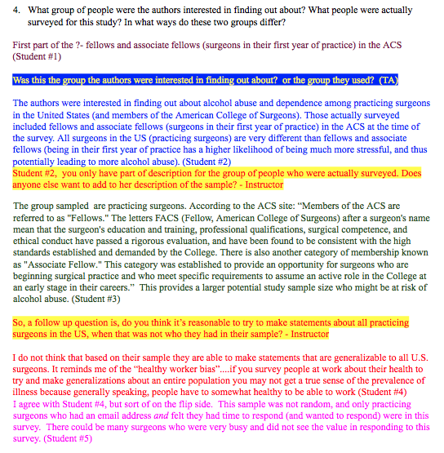
Notes:
Example from a collaborative key

Slide 18
Student Feedback: Collaborative Keys
“Most helpful to me in my learning process was the back and forth on the collaborative learning documents - that was great to see what other people thought and what the professor's answers were.”
“The concept and literature activities, it was almost like being in a class setting where students raise their hands and give their answers, the answers may not be correct all the time but the professor and TAs and other students correct as needed which is very helpful.”
Notes:
From the end of semester survey: “What aspect of the course has been the MOST HELPFUL to you in your learning?”:

Slide 19
Active Learning Classroom Benefits
Biostatistics is scary; active learning allows students to do the hard parts in a supportive environment, with classmates, instructors nearby to help.
vs. traditional approach: students wrestle with the hard parts alone at home doing the homework.
More challenging material can be used, since the instructors are on hand to help.
It keeps students engaged.
Learning is enhanced and reinforced by explaining to / arguing with classmates.
Plus it is way more fun!
Notes:
SAME benefits online as in-person!!

Slide 20
Acknowledgements
Our awesome Biostatistics teaching group
Our School of Public Health’s Office of E-Learning Services, led by Dr. Sara J. Hurley

Slide 21
Abstract
The flipped classroom model, in which the passive parts (e.g. lectures) are moved outside of class and the active parts (e.g. assignments) are moved into class, is typically used in face-to-face classes. We have successfully used it online in a large introductory biostatistics course. Students in both in-person and online sections are required to prepare for the unit by reading the textbook or listening to recorded lectures. In-person students spend the in-class time working individually or in groups to complete learning activities in which they explore and apply the concepts. In an effort to reproduce the active learning classroom online without face-to-face meetings, we implemented two modifications. First, the online students are encouraged to work on the learning activities in pairs or groups using tools such as Skype or FaceTime. Second, class discussion is carried out through “collaborative keys” in which students work collaboratively to create the answer key for each learning activity, monitored and guided by the instructor team. This talk will describe our approach and provide some preliminary evidence about its effectiveness and ability to engage students.

